Slide 1


Probability - Basics
Shah Ayub Quadri
Ayub.quadri89@gmail.com

Slide 2
Content
Probability
Event
Types of Events
Independent, Dependent, Mutually Exclusive events
Probability
Types of probabilities
Conditional probability
Bayes Theorem
Confusion Matrix
Introduction to R Programming

Slide 3
Probability:
Probability is the measure of how much likelihood that an event will occur.
Probability is qualified between 0 & 1
Higher the probability of an event, more certain that the event will occur
0 – Impossibility of an event
1 – highly certain that even will occur
Eg: Weather condition: “80% chances that it would rain today”
Perspectives on Probability
Classical (A priori or Theoretical)
Empirical (Posterior or Frequentist)
Subjective Probability

Slide 4

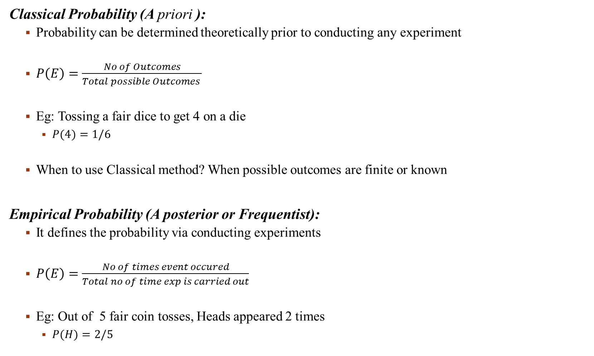
Classical Probability (A priori ):
Probability can be determined theoretically prior to conducting any experiment
$P\left(E\right)=\frac{No of Outcomes}{Total possible Outcomes }$
Eg: Tossing a fair dice to get 4 on a die
$P(4)=1/6$
When to use Classical method? When possible outcomes are finite or known
Empirical Probability (A posterior or Frequentist):
It defines the probability via conducting experiments
$P\left(E\right)=\frac{No of times event occured}{Total no of time exp is carried out}$
Eg: Out of 5 fair coin tosses, Heads appeared 2 times
$P(H)=2/5$

Slide 5
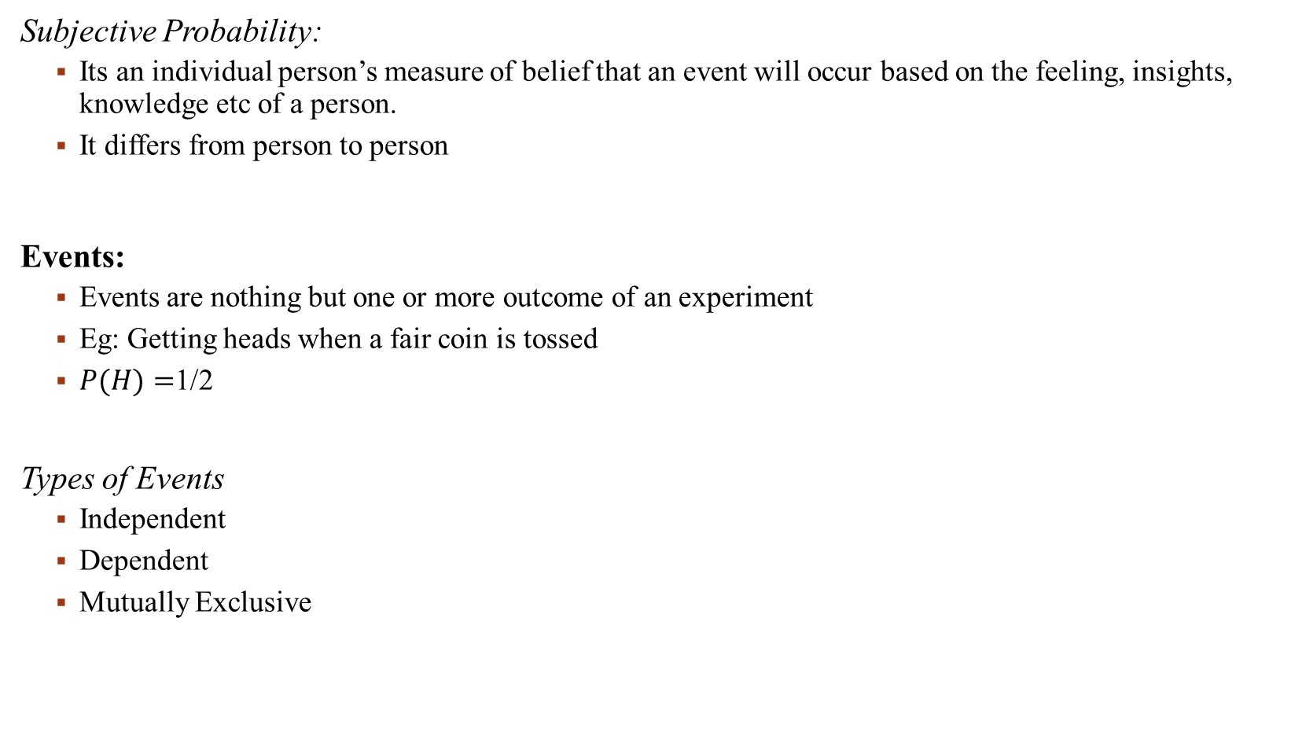
Subjective Probability:
Its an individual person’s measure of belief that an event will occur based on the feeling, insights, knowledge etc of a person.
It differs from person to person
Events:
Events are nothing but one or more outcome of an experiment
Eg: Getting heads when a fair coin is tossed
$P(H)=$1/2
Types of Events
Independent
Dependent
Mutually Exclusive

Slide 6
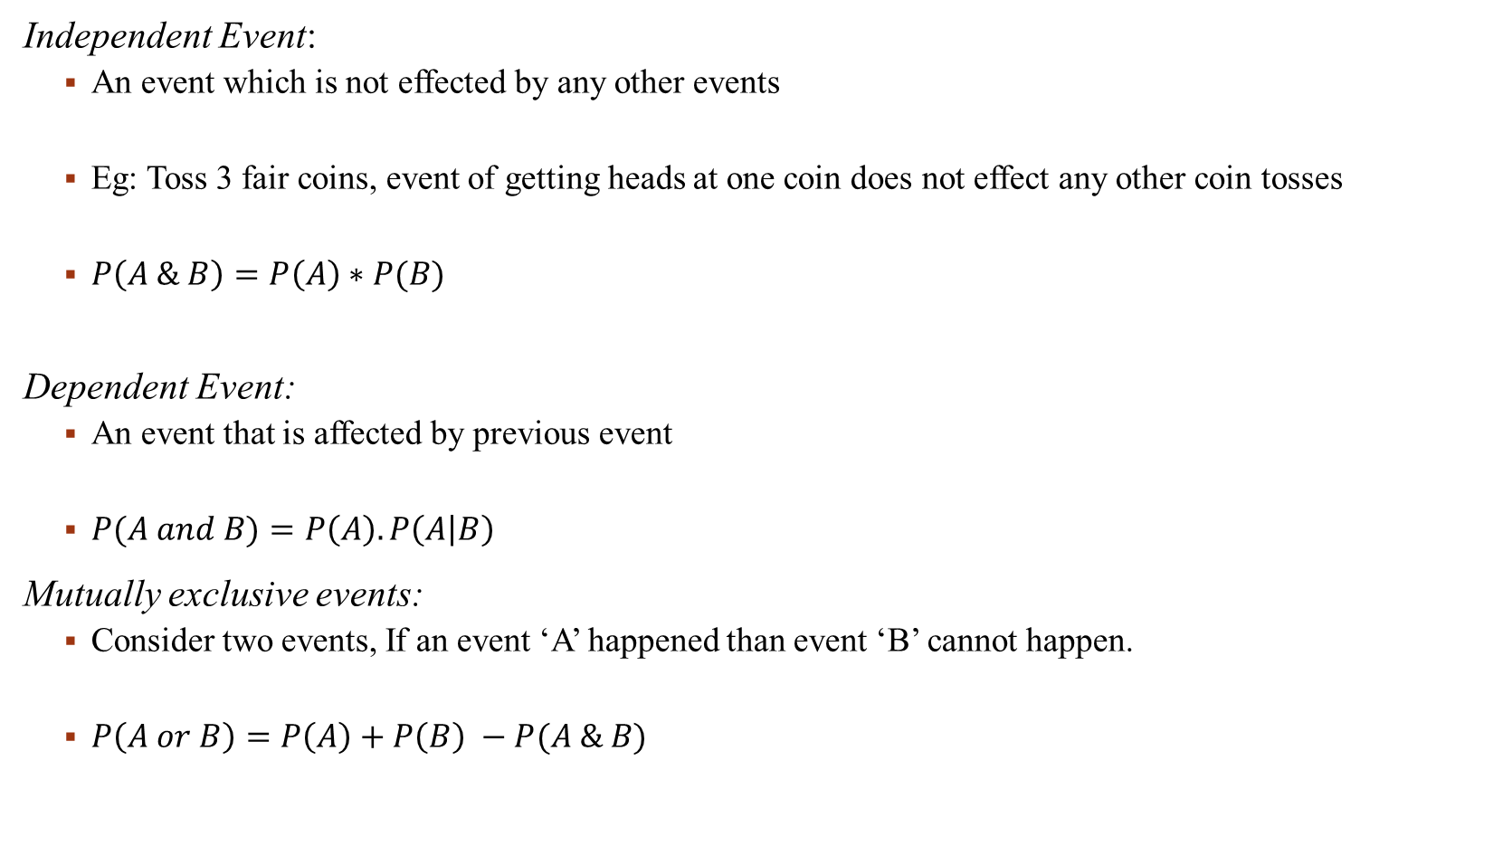
Independent Event:
An event which is not effected by any other events
Eg: Toss 3 fair coins, event of getting heads at one coin does not effect any other coin tosses
$P\left(A \& B\right)=P\left(A\right)∗P(B)$
Dependent Event:
An event that is affected by previous event
$P(A and B)=P\left(A\right).P\left(A | B\right)$
Mutually exclusive events:
Consider two events, If an event ‘A’ happened than event ‘B’ cannot happen.
$P\left(A or B\right)=P\left(A\right)+P\left(B\right) −P(A \& B)$

Slide 7
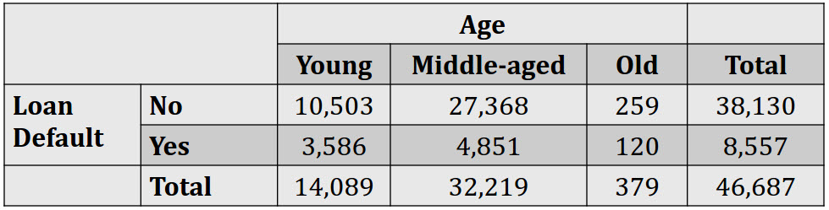
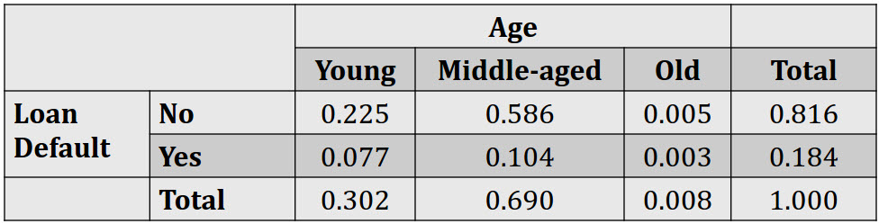
Contingency table summarizing 2 variables, Loan Defaulters vs Age.

Slide 8
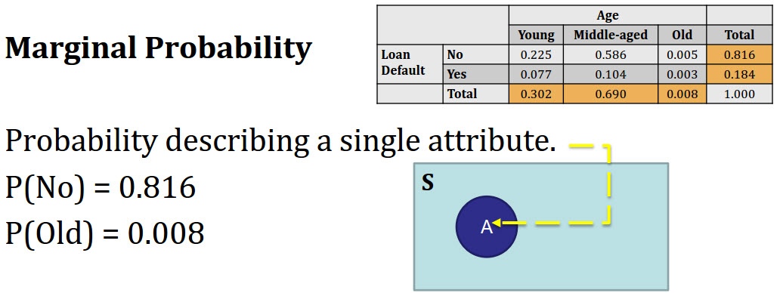
Types of Probabilities

Slide 9
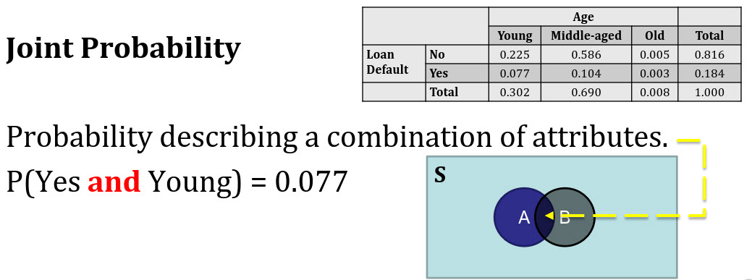

Slide 10
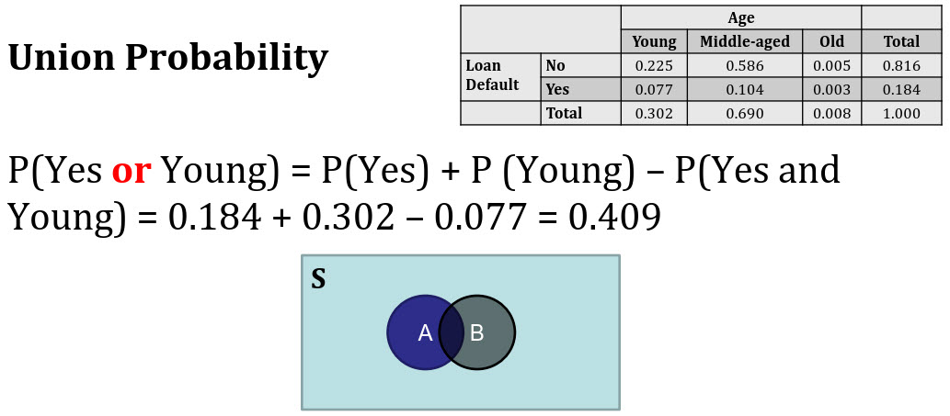

Slide 11
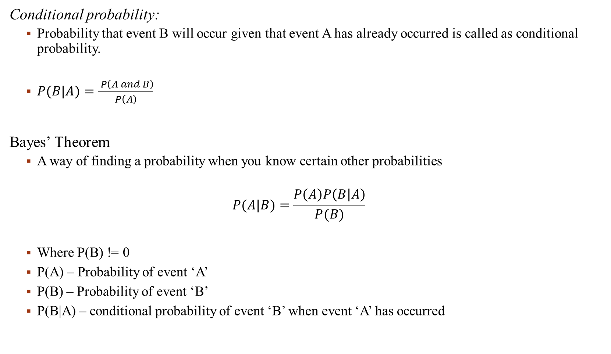
Conditional probability:
Probability that event B will occur given that event A has already occurred is called as conditional probability.
$P(B|A)=\frac{ P\left(A and B\right)}{P\left(A\right)}$
Bayes’ Theorem
A way of finding a probability when you know certain other probabilities
$$P(A|B)=\frac{P\left(A\right)P\left(B | A\right)}{P(B)}$$
Where P(B) != 0
P(A) – Probability of event ‘A’
P(B) – Probability of event ‘B’
P(B|A) – conditional probability of event ‘B’ when event ‘A’ has occurred

Slide 12
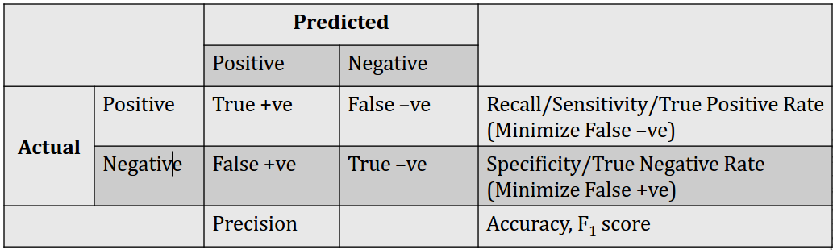

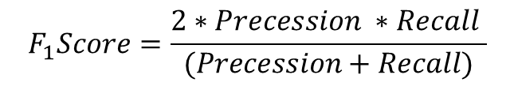

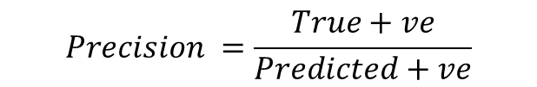
Confusion Matrix
$$Recall=\frac{True+ve}{Actual Total+ve}$$
$$Specificity=\frac{True −ve}{predicted total −ve}$$
$$Precision =\frac{True+ve}{Predicted+ve}$$
$$F_{1}Score=\frac{2∗Precession ∗Recall }{(Precession+Recall)}$$
$$Accuracy =\frac{\left(True+ve\right)+(True −ve) }{\left(True+ve\right)+\left(False+ve\right)+\left(False −ve \right)+(True −ve)}$$

Slide 13
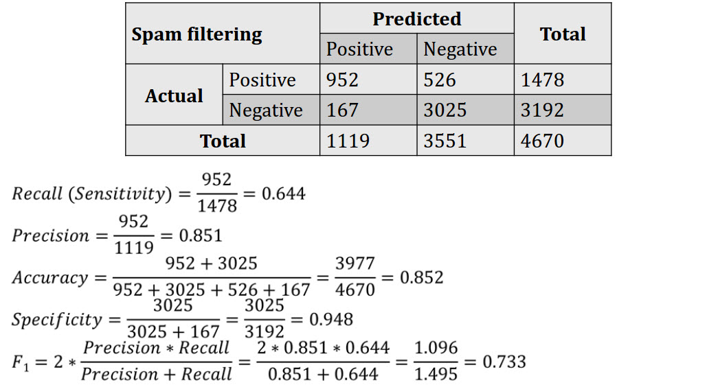
Problem 1: Spam Filter

Slide 14
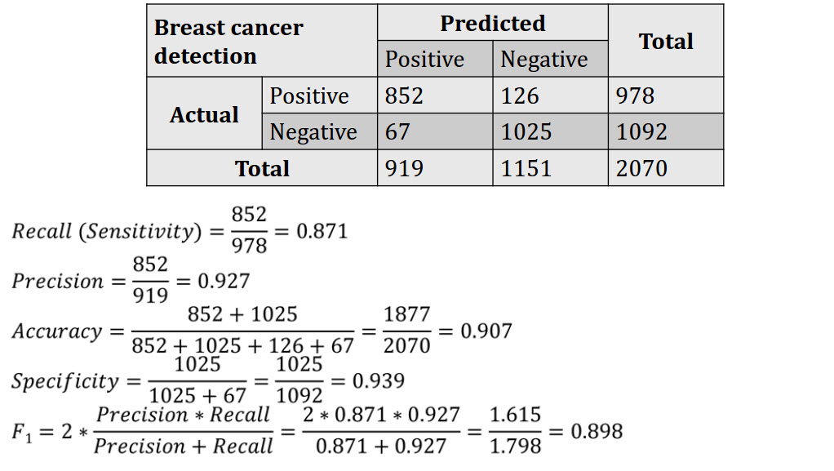
Problem 2: Breast Cancer

Slide 15
Interview Question:
Q. You have been tasked to build a classifier for cancer diagnosis. It is of high importance that patients with cancer can be diagnosed wrongly as negative but patients without cancer should NEVER be diagnosed as positive.
Which of the following classification models would you prefer?
(Assuming: Positives = Cancer, Negatives = Not cancer)
Options:
True Positive Rate [which is = True Positive / Actual Positive]
True Negative Rate [which is = True Negative / Actual Negative]
Precision [which is = True Positive / Predicted Positive]
Total Accuracy [which is = (True Positive + True Negative) / Total Population]
Answer – Precision

Slide 16
References
Probability & statistics
http://www.mathsisfun.com/data/index.html#stats
Short definition & terms in probability and statistics
http://stattrek.com
Conditional probability explained visually
https://www.khanacademy.org/video/conditional-probability2
Bayes Theorem:
https://youtu.be/E4rlJ82CUZI
Confusion Matrix
http://www.dataschool.io/simple-guide-to-confusion-matrix-terminology/

